Slide 1

Tutorial
By Yifan ZHU

Slide 2


Contents
Assignment 2 Solutions
Basics about HTAP (extension to the lecture)

Slide 3
Determine with explanations and examples (where appropriate) if each of the following is a trivial functional dependency, where Φ is the empty set, and A ≠ Φ,
A → Φ
Φ → Φ
Φ → A

Slide 4
A → Φ is trivial because Φ is a subset of every set
Φ → Φ is also trivial because Φ is a subset of every set, including itself, i.e. Φ ⊆ Φ
Φ → A is non-trivial because Φ → A means the value of A can be determined without using any other value; in other words the value of A must be the same for every tuple in R. This is not the same as saying that A has no determinants or that A is null. If there were no determinants for A, then A would be unconstrained and could have different values in different tuples. An example of a dependency on the empty set might be the sex attribute in a Members relation that defines the membership of a men-only club: Φ → sex.

Slide 5
Consider the relation R(A₁, A₂, …, A_{n}), where each A_{i}, i = 1, 2, …, n, is an atomic (i.e. simple) attribute. Let F be an arbitrary set of functional dependencies on R, show that
|F⁺| ≤ 2^{2n} .
The left-hand and right-hand sides of a functional dependency are both subsets of R, and is an element of the power set of the set S = {A₁, A₂, …, A_{n}}, i.e. ℘(S). [Note: the power set ℘(S) of a set S is the set of all subsets of S.] Now, the cardinality of the power set
|℘(S)| = 2^{n},
which can be seen by considering each element of S, and whether or not to include the element in the particular subset. Thus, by considering both the left-hand side and right-hand side and exhausting all possibilities, the number of possible functional dependencies is
|℘(S)|⨉ |℘(S)| = 2^{n} ⨉ 2^{n}= 2^{2n} .
Therefore, we can conclude that
|F⁺| ≤ 2^{2n} .

Slide 6
Consider a relation consisting of the attributes A, B, C, with the following set of functional dependencies F
A → BC
B → AC
C → AB
Determine four different canonical covers for F.

Slide 7
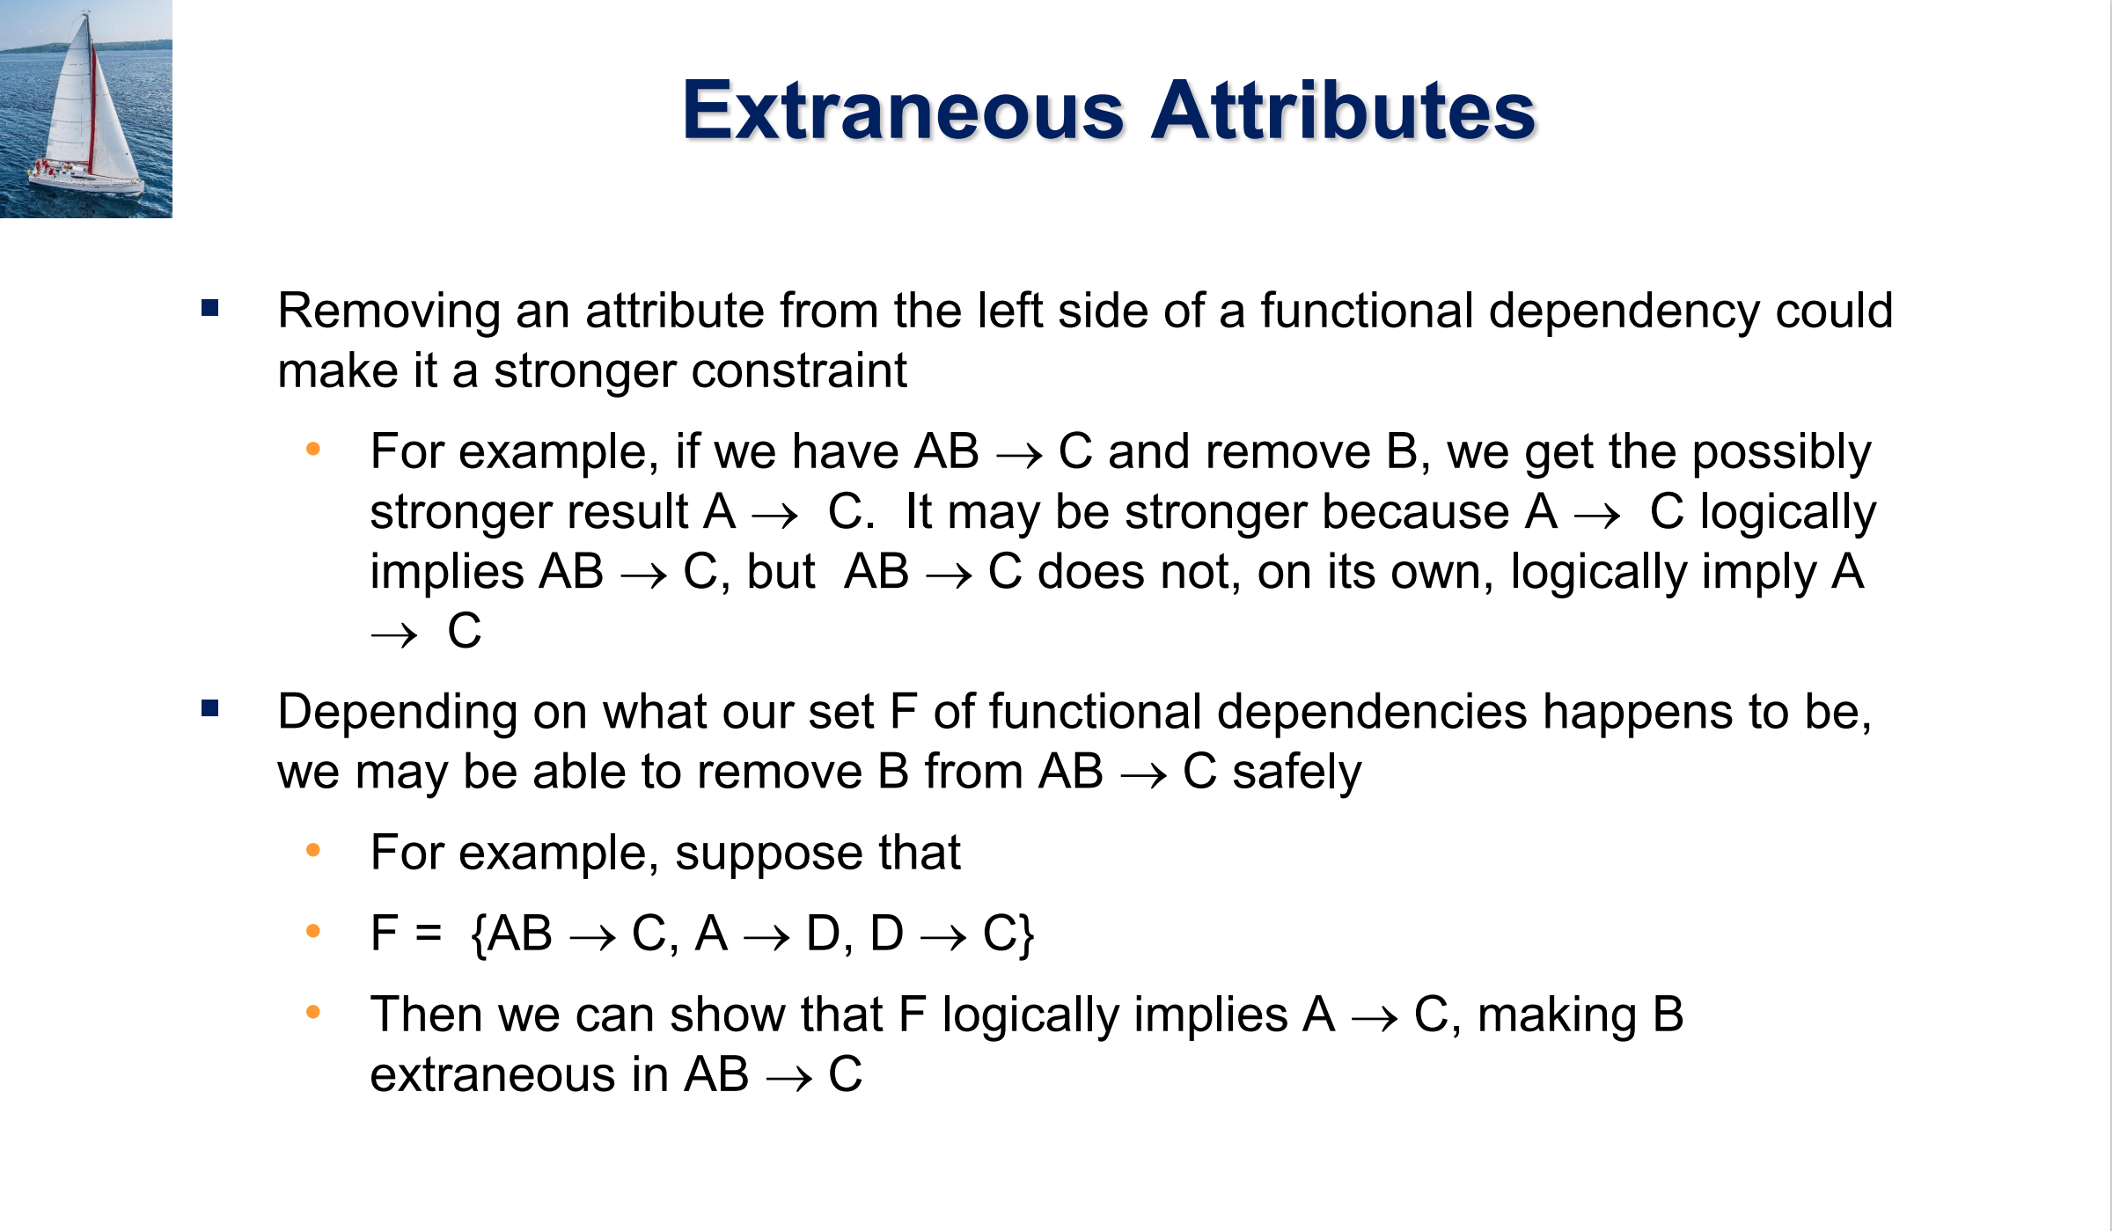

Slide 8
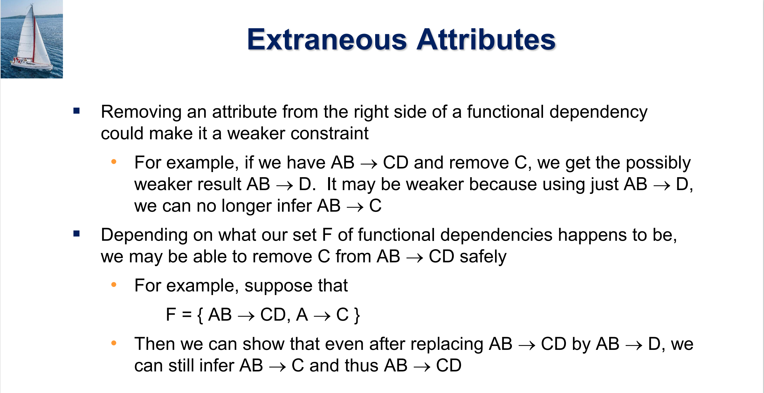

Slide 10
Consider a relation consisting of the attributes A, B, C, with the following set of functional dependencies F
A → BC
B → AC
C → AB
Determine four different canonical covers for F.
if C is deleted from the A → BC, we get F’ = {A → B, B → AC, C → AB} and from the first 2 FDs here we get back A → BC; hence C is extraneous in A → BC.
Next, deleting B from C → AB in F’, we get {A → B, B → AC, C → A} and we get back C → AB from the first and third FDs; hence B is extraneous in C → AB.
Next, deleting A from B → AC, we get {A → B, B → C, C → A} & we get back B → AC from the last two FDs; hence A is extraneous in B → AC, and we get the canonical cover
{A → B, B → C, C → A} (1)

Slide 11
Consider a relation consisting of the attributes A, B, C, with the following set of functional dependencies F
A → BC
B → AC
C → AB
Determine four different canonical covers for F.
On the other hand, deleting A from C → AB in F’ we get F” = {A → B, B → AC, C → B} & we get back C → AB from the last two FDs & using the decomposition rule on the second FD; hence A is extraneous in C → AB
Is A extraneous in B → AC here? Now deleting A, we get {A → B, B → C, C → B} but we cannot get back B → A; thus A is not extraneous. By symmetry of A and C in F”, C is not extraneous either, and we get the canonical cover
{A → B, B → AC, C → B} (2)

Slide 12
Consider a relation consisting of the attributes A, B, C, with the following set of functional dependencies F
A → BC
B → AC
C → AB
Determine four different canonical covers for F.
By symmetry of A and B in F, and deleting B first, we get another two canonical covers
{A → C, C → B, B → A}
{A → C, C → AB, B → C}.
Therefore, we obtain the following four different canonical covers
{A → B, B → C, C → A}
{A → C, C → B, B → A}
{A → B, B → AC, C → B}
{A → C, C → AB, B → C}.

Slide 13
Prove that functional dependency satisfies the formal definition of multivalued dependency.
Now, we have for the definition the MVD α →→ β
t₁ [α] = t₂ [α] = t₃ [α] = t₄ [α] t₃ [β] = t₁ [β] and t₄ [β] = t₂ [β] t₃ [γ] = t₂ [γ] and t₄ [γ] = t₁ [γ]
Letting t₄ = t₁ and t₃ = t₂, then if t₁ [α] = t₂ [α] the second line of the above gives
t₂ [β] = t₁ [β] and t₁ [β] = t₂ [β], which is the definition of FD.
Thus the MVD definition includes FD, or every FD is also an MVD.
(enhance the constraint)

Slide 14
Consider the following relations for an order processing application database at company Global-UK.
Order (O#, Odate, Cust#, Total_amount)
Order-Item (O#, I#, Qty_ordered, Total_price, Discount%)
Here O#, I#, Cust# denote respectively the order number, item number, and customer number. Assume that each item has a different discount. The Total_price refers to the total price of one item, Odate is the date on which the order was placed, and the Total_amount is the amount of the order. Let us apply a natural join on the relations Order-Item and Order and call the result RelationX.
Write down the schema of RelationX.
Determine the primary key for RelationX.
What are the functional dependencies of RelationX. You should state clearly any assumptions that you make. These assumptions should be reasonable assumptions.
Is RelationX in 2NF or 3NF? You should justify your answers.

Slide 15
i) The schema of Order * Order_Item would be:
RelationX (O#, I#, Odate, Cust#, Total_amount, Qty_ordered, Total_price, Discount%)
(ii) Its primary key is O#,I#.
(iii) The reasonable functional dependencies are:
O#I# → Qty_ordered
O#I# → Total_price
O#I# → Discount%
O# → Odate
O# → Cust#
O# → Total_amount
(iv) It is not in 2NF, as attributes Odate, Cust#, and Total_amount are only partially dependent on the primary key, O#I#.
It is also not in 3NF, as 2NF is a requirement for 3NF.

Slide 16
Consider the relation concerning refrigerators
Ref (Model#, Year, Price, Manuf_Plant, Color)
and the following set of functional dependencies:
Model# → Manuf_Plant
Model#, Year → Price
Manuf_Plant → Color
Evaluate each of the following as a candidate key for Ref, giving reasons why it can or cannot be a candidate key:
{Model#},
{Model#, Year},
{Model#, Color}.
Based on the result of (i) above, determine whether the relation Ref is in 3NF and whether it is in BCNF. You should justify your answers.
Consider the decomposition of Ref into
R₁ (Model#, Year, Price)
R₂ (Model#, Manuf_Plant, Color)
Determine whether this is a lossless decomposition. You should justify your answers.

Slide 17
Abbreviating the fields as Ref (M#, Y, P, MP, C),
{M#} IS NOT a candidate key since it does not functionally determine attributes Y or P.
{M#, Y} IS a candidate key since it functionally determines the remaining attributes P, MP, and C. This can be seen as follows.
{M#, Y} → P,
But M# → MP
By augmentation {M#, Y} → MP
Since MP → C, by transitivity M# → MP, MP → C, gives M# → C
By augmentation {M#, Y} → C
Thus {M#, Y} → P, MP, C and {M#, Y} can be a candidate key
{M#, C} IS NOT a candidate key since it does not functionally determine attributes Y or P.

Slide 18
Ref is not in 2NF, due to the partial dependency {M#, Y} → MP (since {M#} → MP holds). Therefore, Ref is neither in 3NF nor in BCNF.
Alternatively: BCNF can be directly tested by using all of the given dependencies and
finding out if the left-hand side of each is a superkey (or if the right-hand side is a prime attribute). Since neither M# nor MP is a superkey, and Color is not a prime attribute, we can conclude that Ref is neither in 3NF nor in BCNF.
Now R1 ∩ R2 = M#
and M# → MP, and MP → C, giving by transitivity M# → C. Thus, we have M# → MP, and M# → C, and thus M# is a superkey of R2. From the lecture notes, this fulfils the requirement of lossless decomposition. Hence the given decomposition is lossless.

Slide 19
How does Real-world Workloads Look Like？

Slide 20


Slide 21
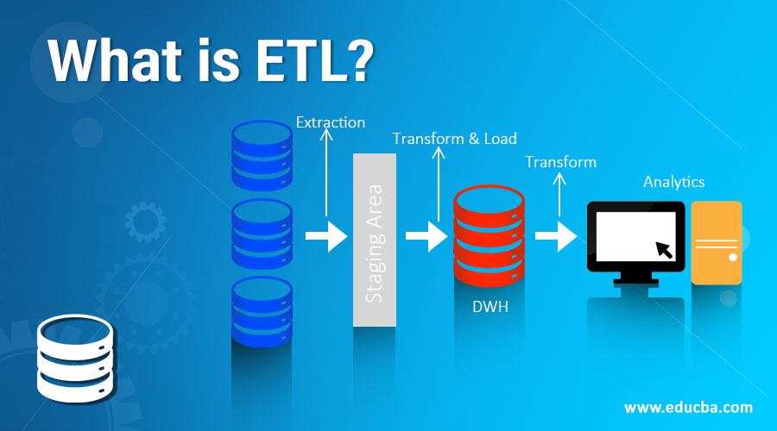

Slide 22
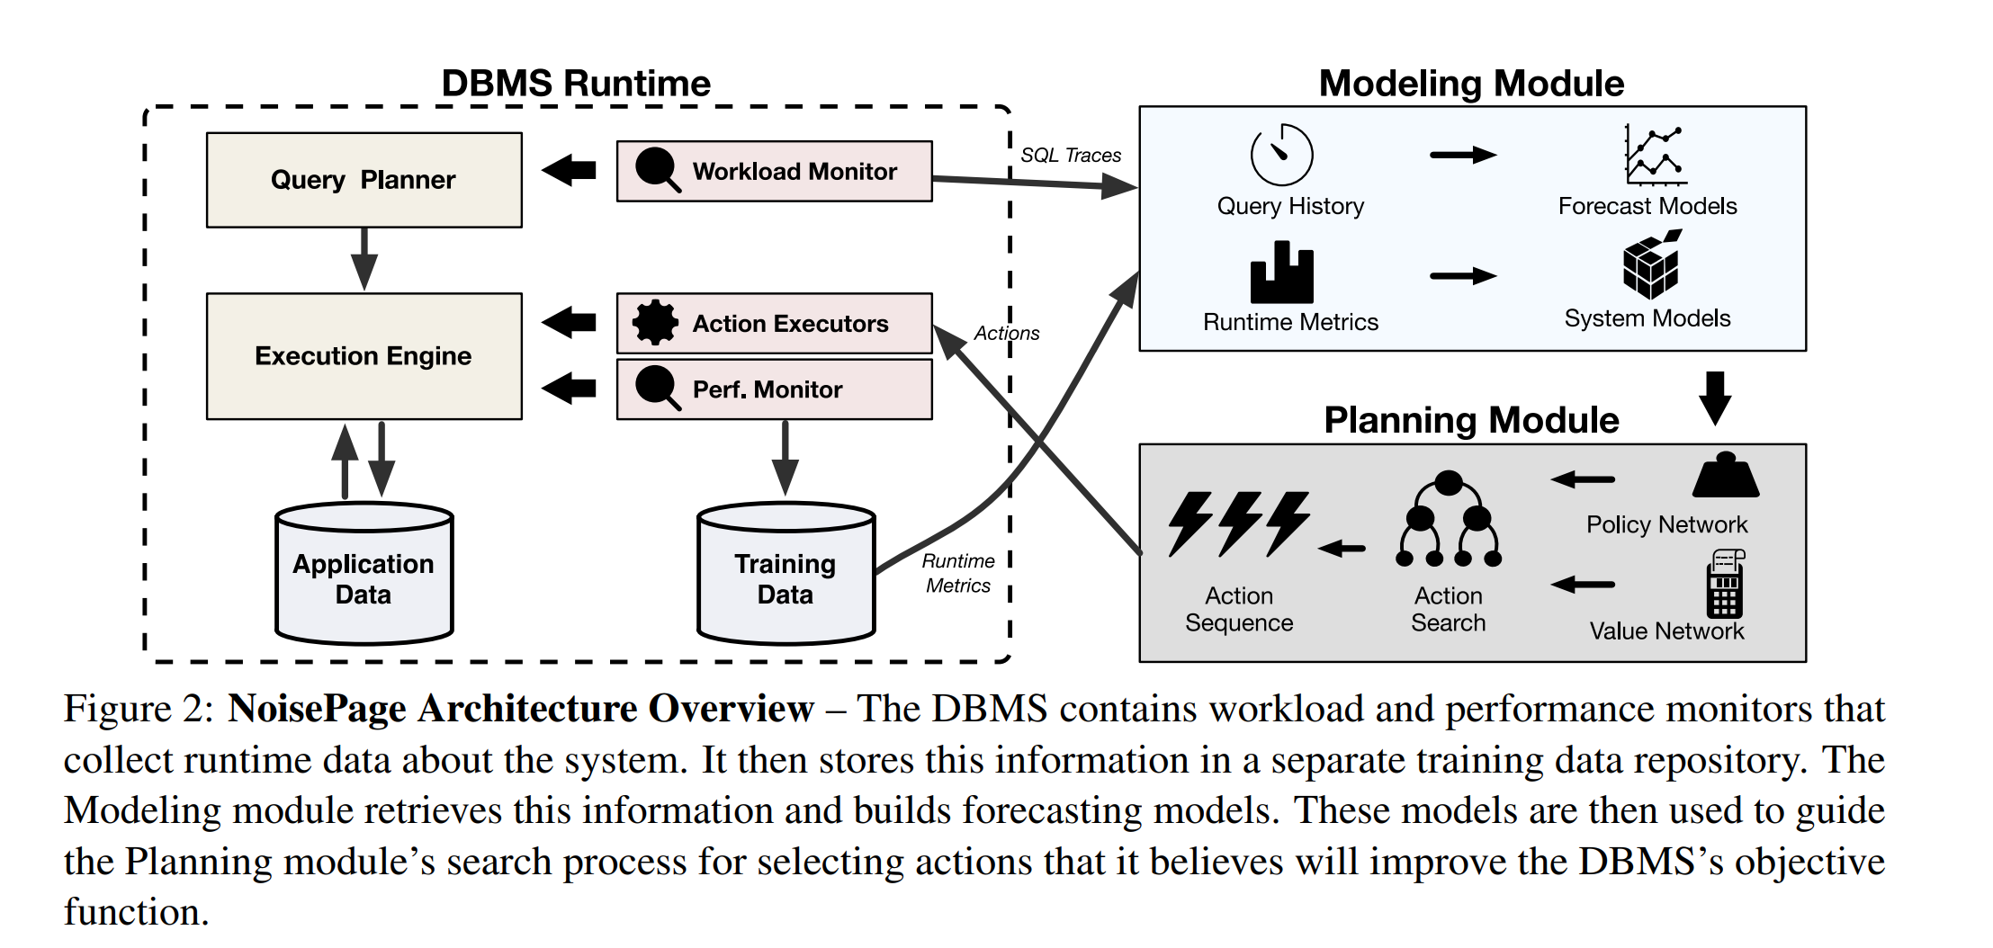

Slide 23
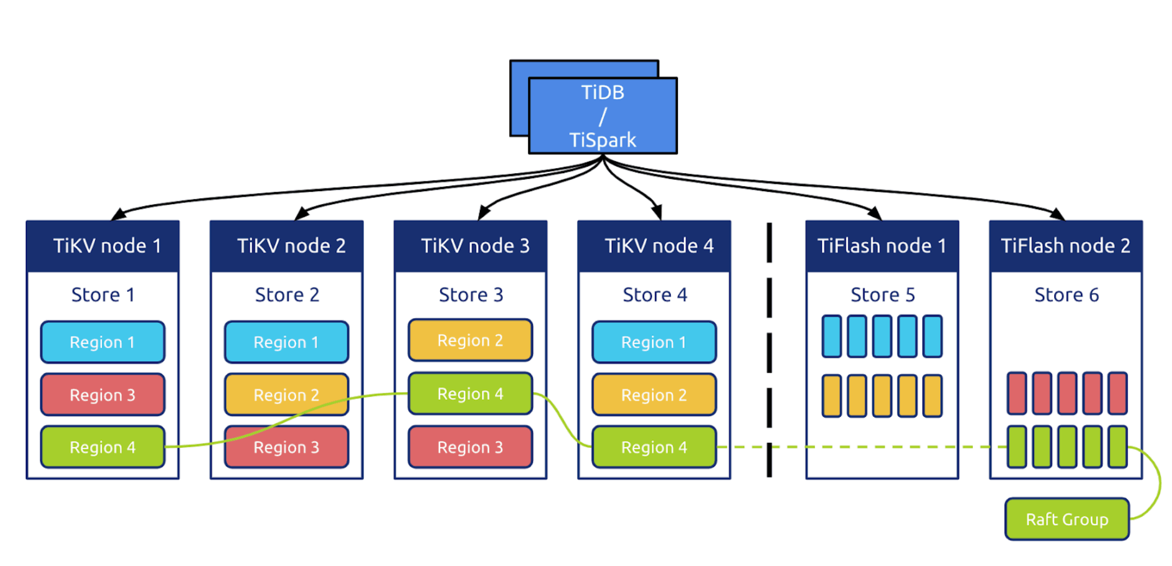

Slide 24

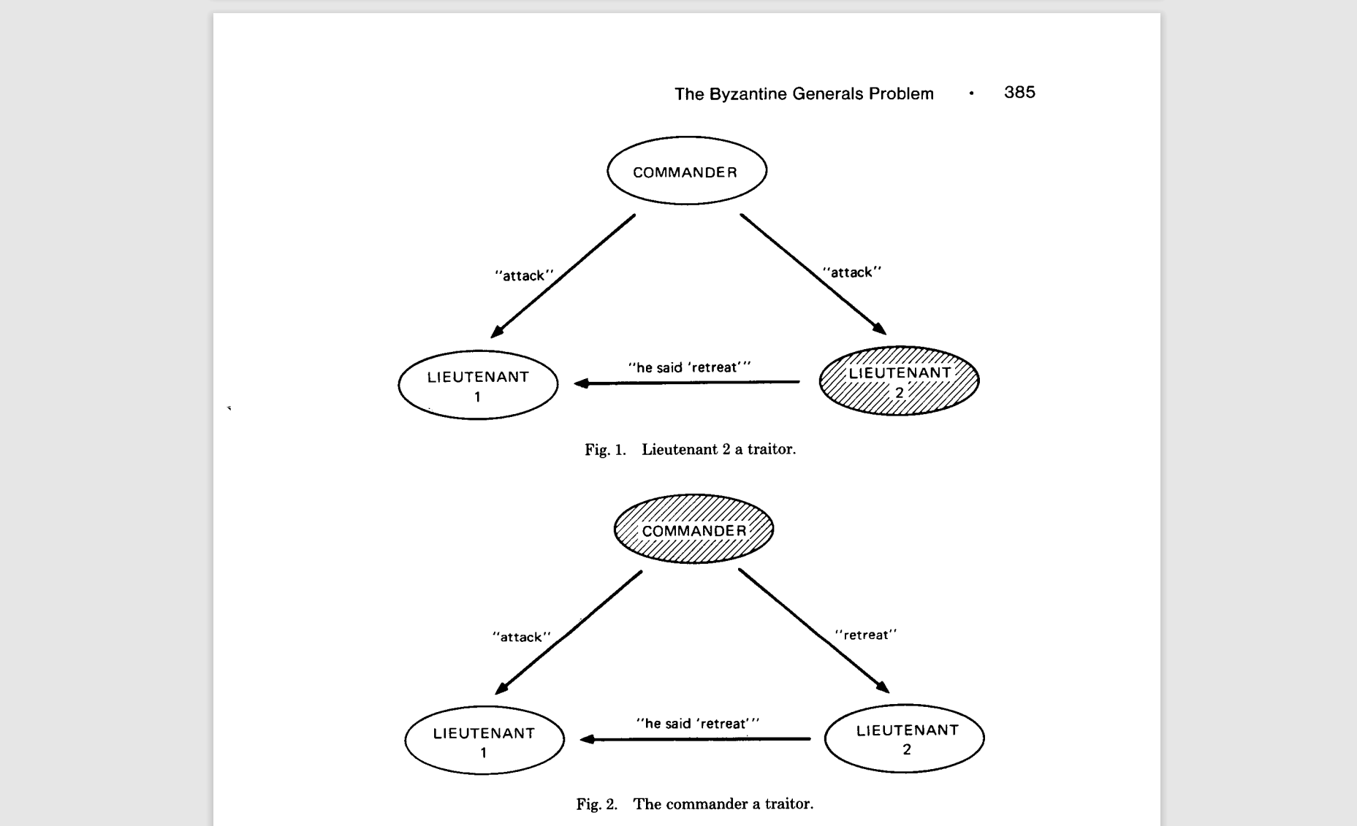
Distributed Consensus

Slide 25
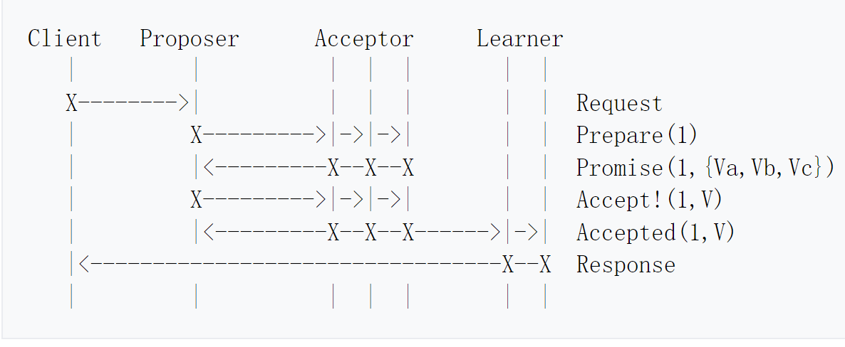
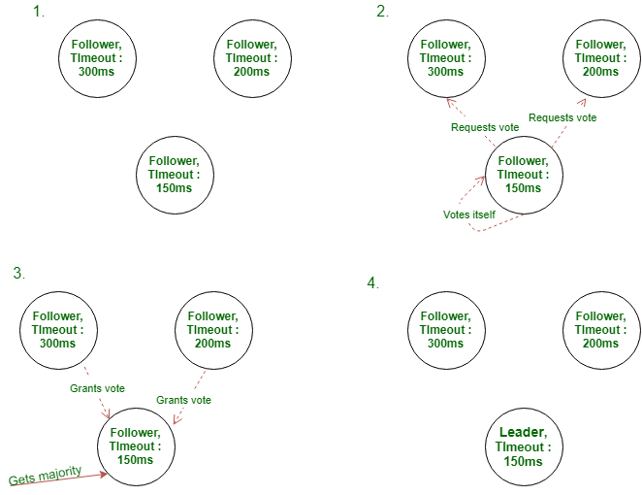
Distributed Consensus

Slide 26
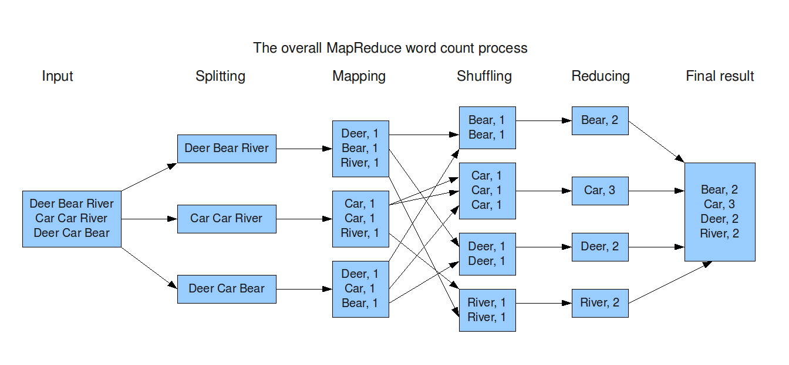
Parallel Processing

Slide 27
Parallel Processing
MPP vs MapReduce

Slide 28

Vectorization

Slide 29
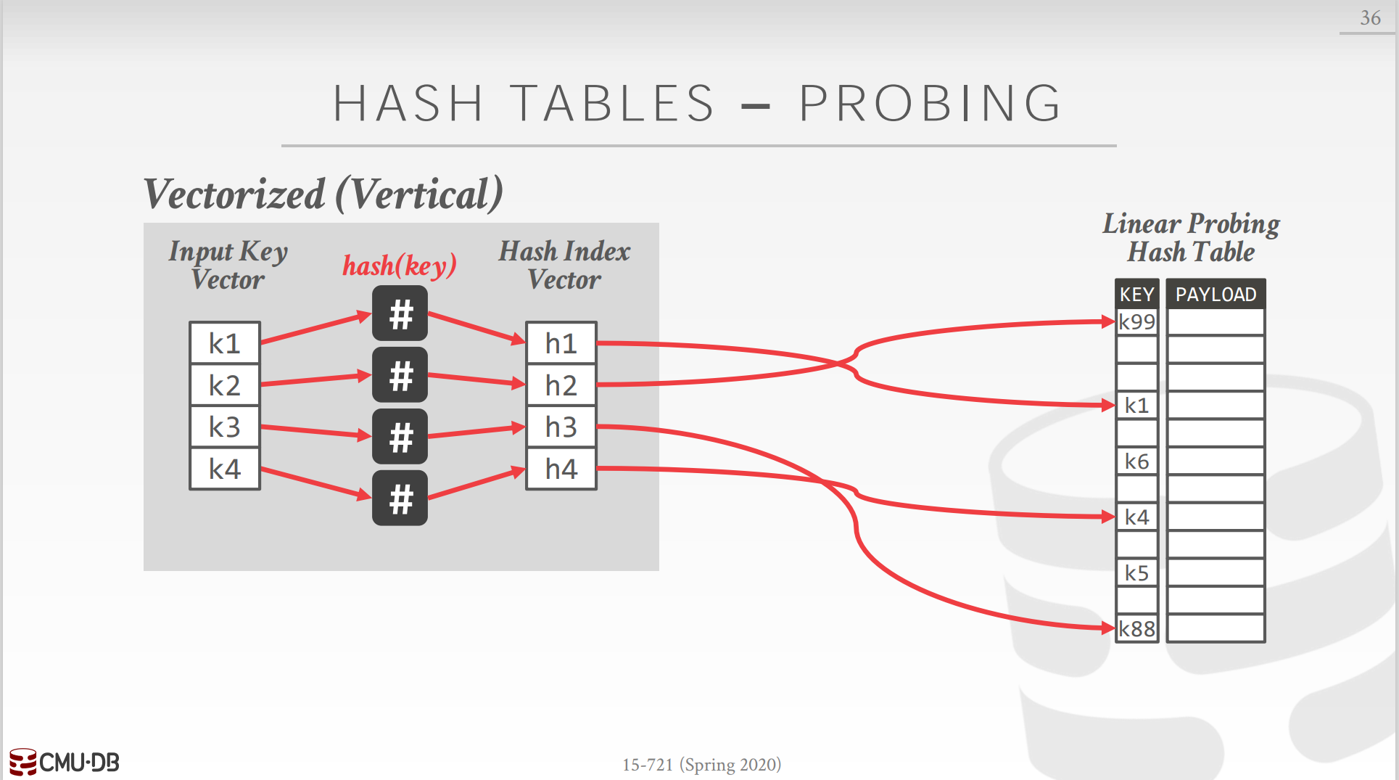
Vectorization

Slide 30
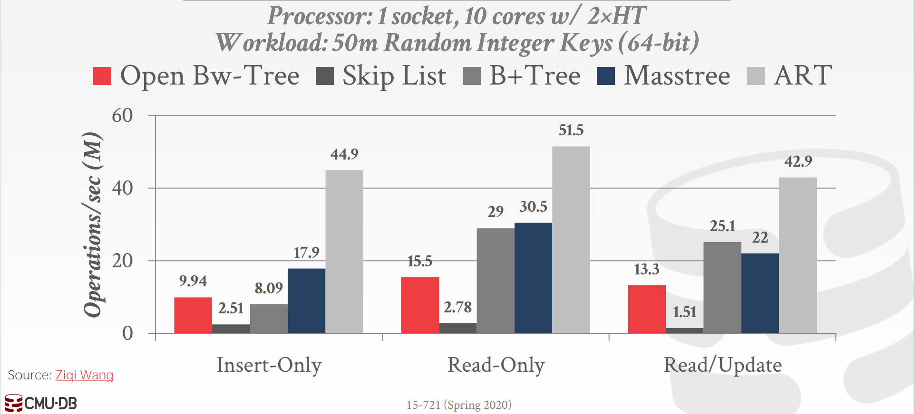
OLTP Index

Slide 31
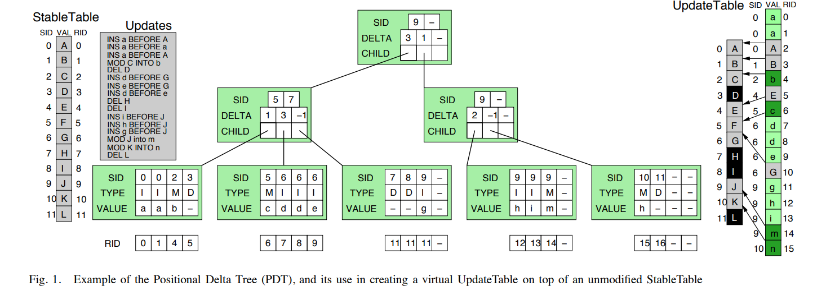
OLAP Index

